Slide 1
SOLID Principles
Sean Chambers

Slide 2
Sample Code
http://www.github.com/schambers/solid-principles/
Click “download” button, or go to bottom and click link to download zip package

Slide 3
Contact/Links
Blog
http://schambers.lostechies.com Twitter
schambers
Sample Code & Presentation
http://github.com/schambers/solid-principles

Slide 4
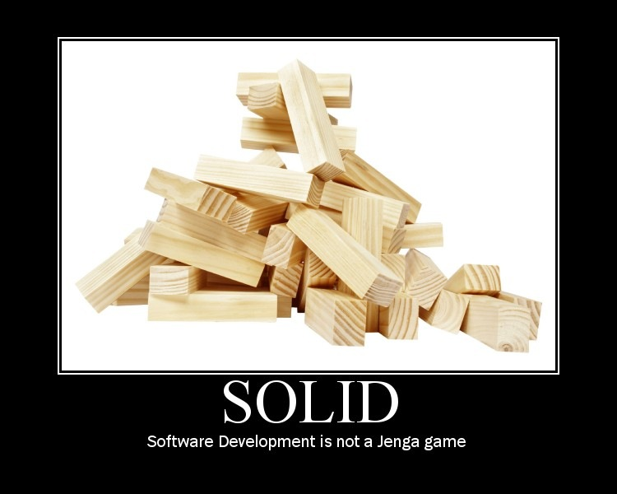
SOLID Principles

Slide 5
SOLID Acronyms
Single Responsibility Principle
Open Closed Principle
Liskov Substitution Principle
Interface Segregation Principle
Dependency Inversion Principle

Slide 6
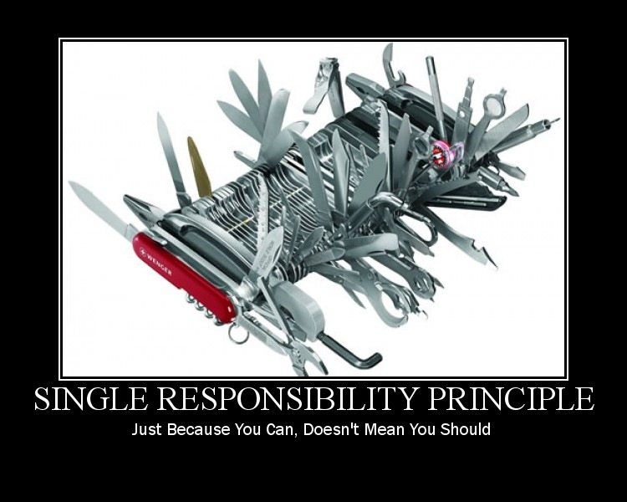
Single Responsibility Principle

Slide 7
SRP Definition
There should never be more than one reason for a class to change.

Slide 8
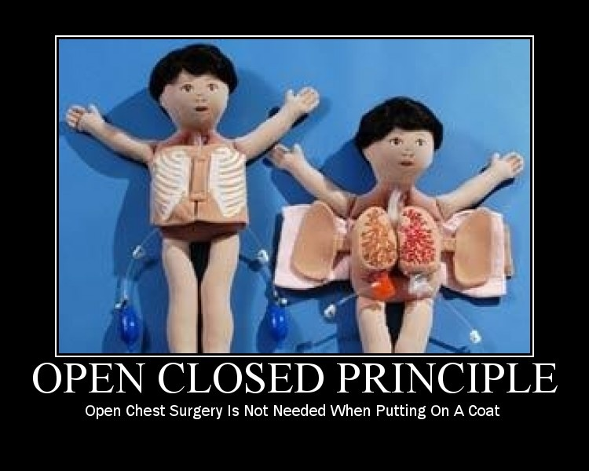
Open Closed Principle

Slide 9
OCP Definition
A class should be open for extension but closed for modification.

Slide 10
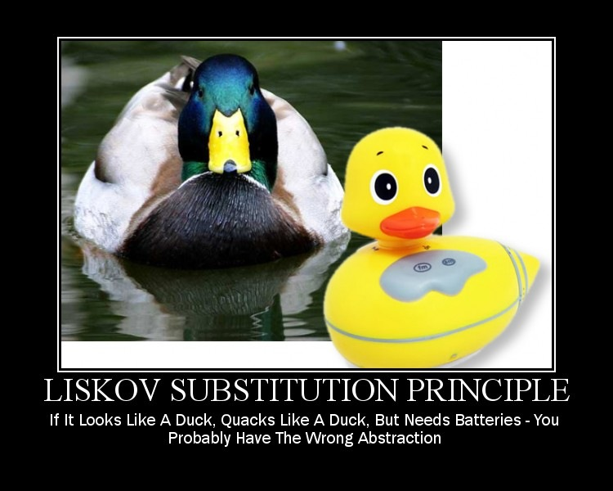
Liskov Substitution Principle

Slide 11
LSP Definition
Shortened Definition: Functions that use pointers or references to base classes must be able to use objects of derived classes without knowing it.

Slide 12
LSP Definition
Actual Definition:
Let q(x) be a property provable about objects x of type T. Then q(y) should be true for objects y of type S where S is a subtype of T

Slide 13
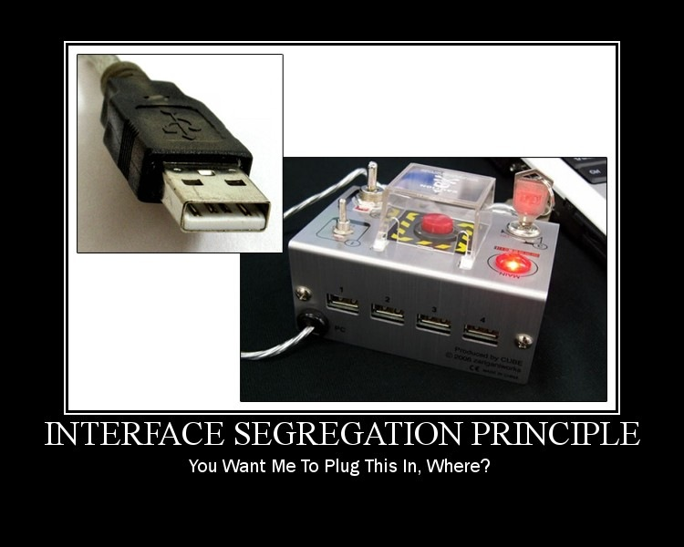
Interface Segregation Principle

Slide 14
ISP Definition
Clients should not be forced to depend upon interfaces that they do not use.

Slide 15
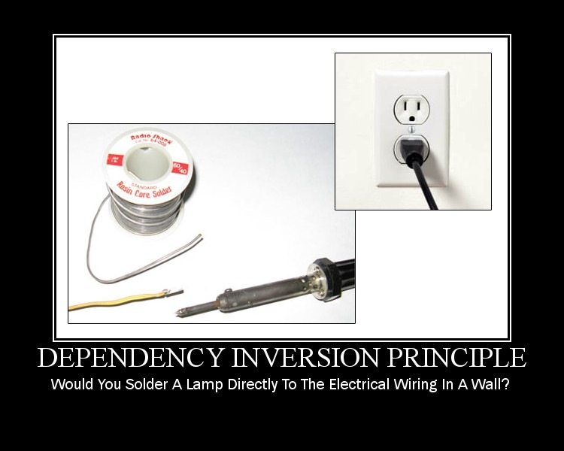
Dependency Inversion Principle

Slide 16
DIP Definition
High level modules should not depend upon low level modules. Both should depend upon abstractions.
Abstractions should not depend upon details. Details should depend upon abstractions.

Slide 17
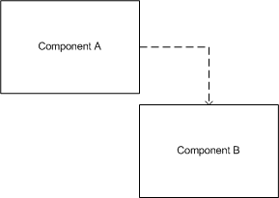
High level modules tightly coupled to Low level modules

Slide 18
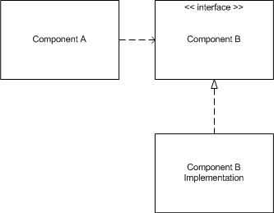
Decoupling of High level modules from Low level modules

Slide 19

Questions?

Slide 20
Sean Chambers
http://schambers.lostechies.com
Twitter: schambers
Sample Code
http://github.com/schambers/solid-principles/

